Slide 1
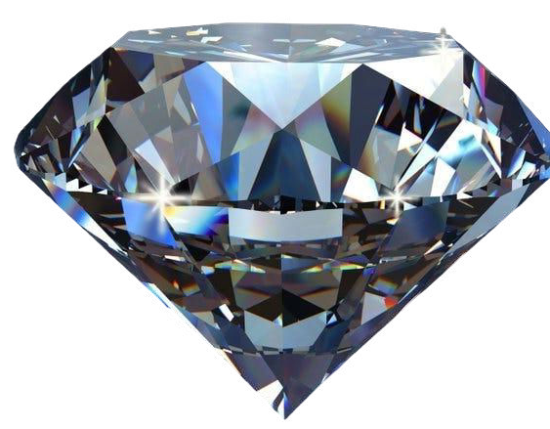
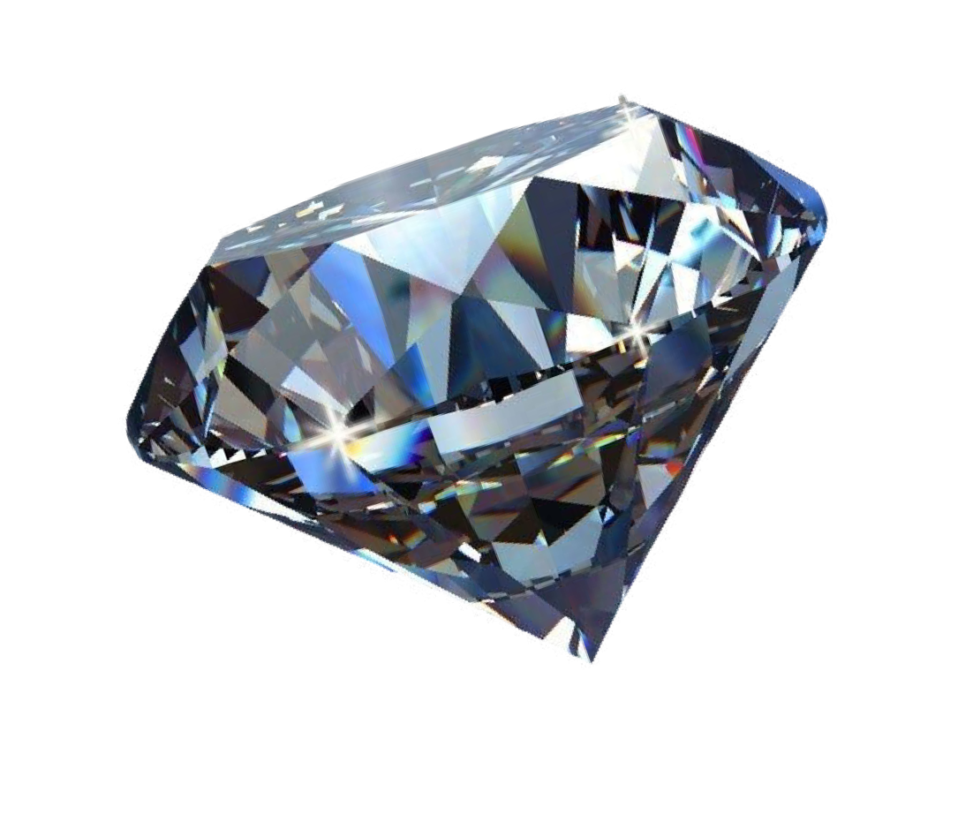
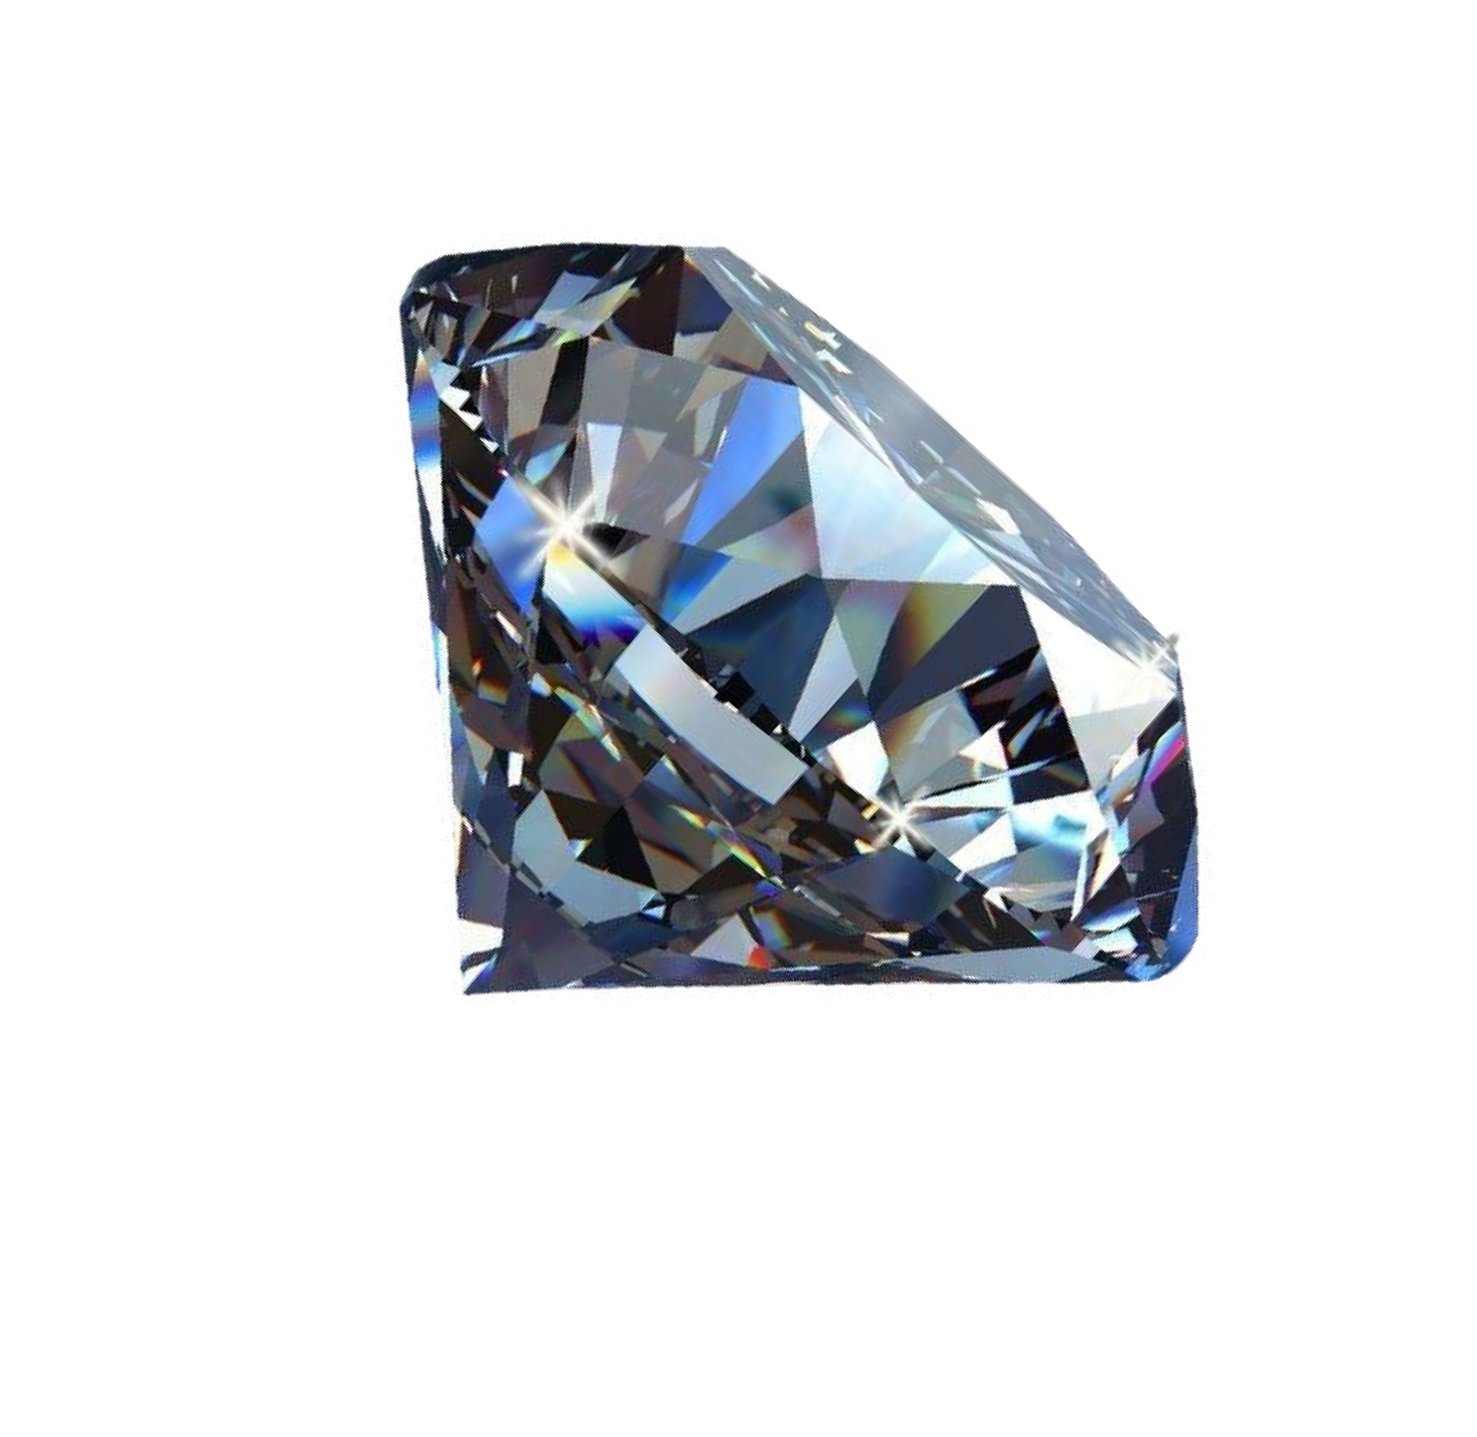
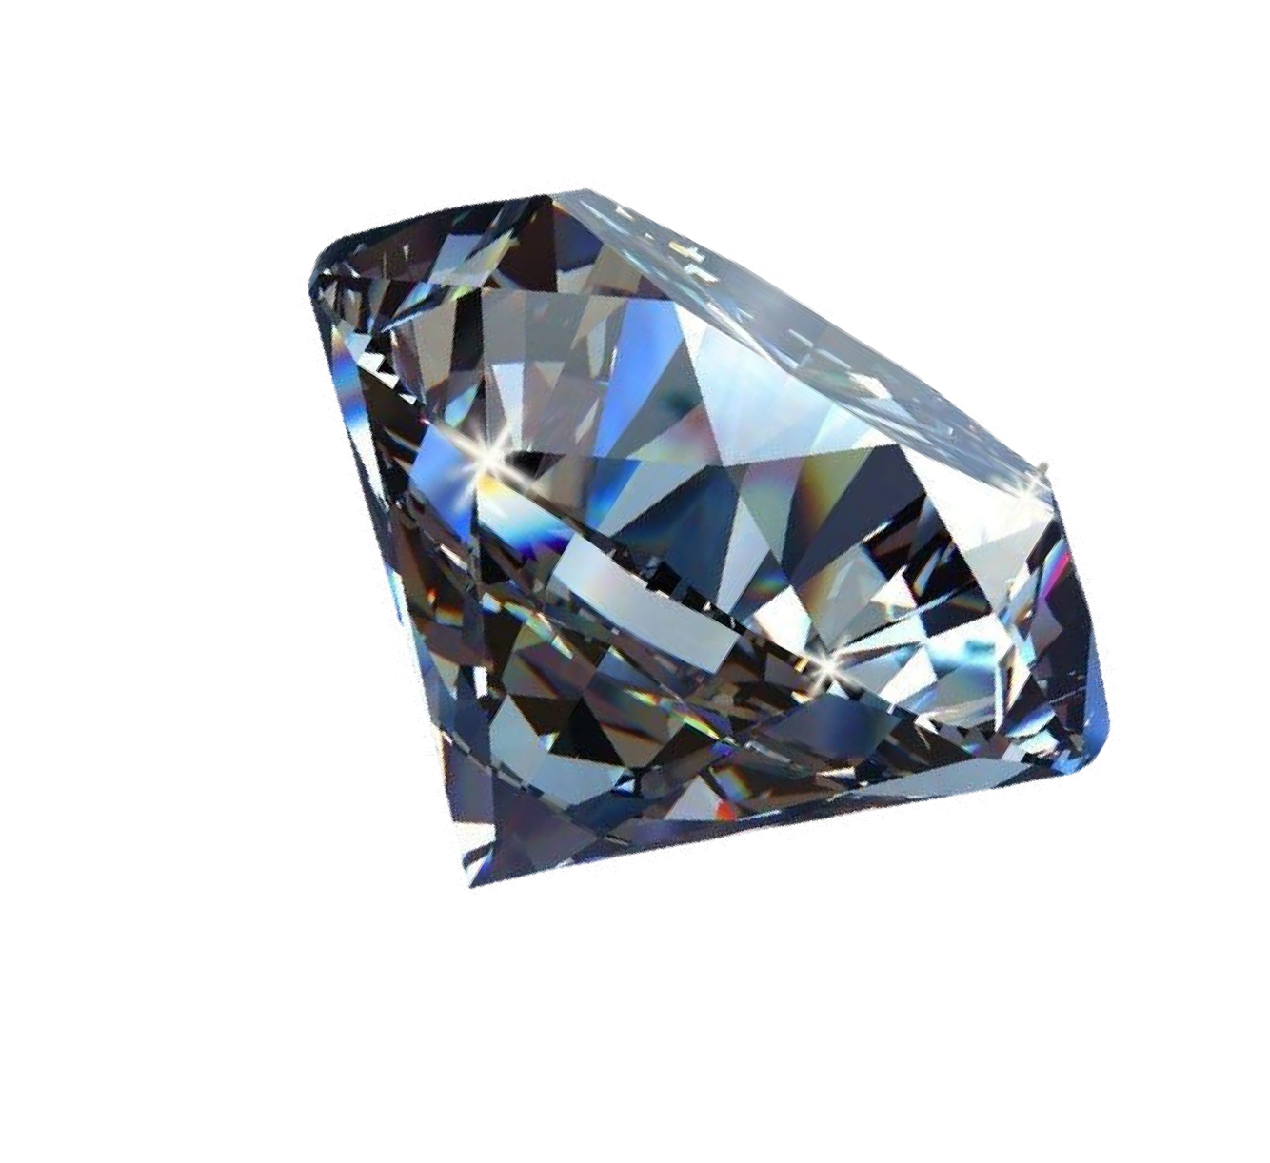
Diamond Price Prediction using Machine learning
Presented by
Ashutosh Kumar
Roll no: 2205016
Branch: CSE-DS
Session: 2022-26

Slide 2
Agenda:
Project Goal
Dataset EDA :
Data Pre-processing
Descriptive Analytics Predictive Analytics Recommendations Conclusions

Slide 3

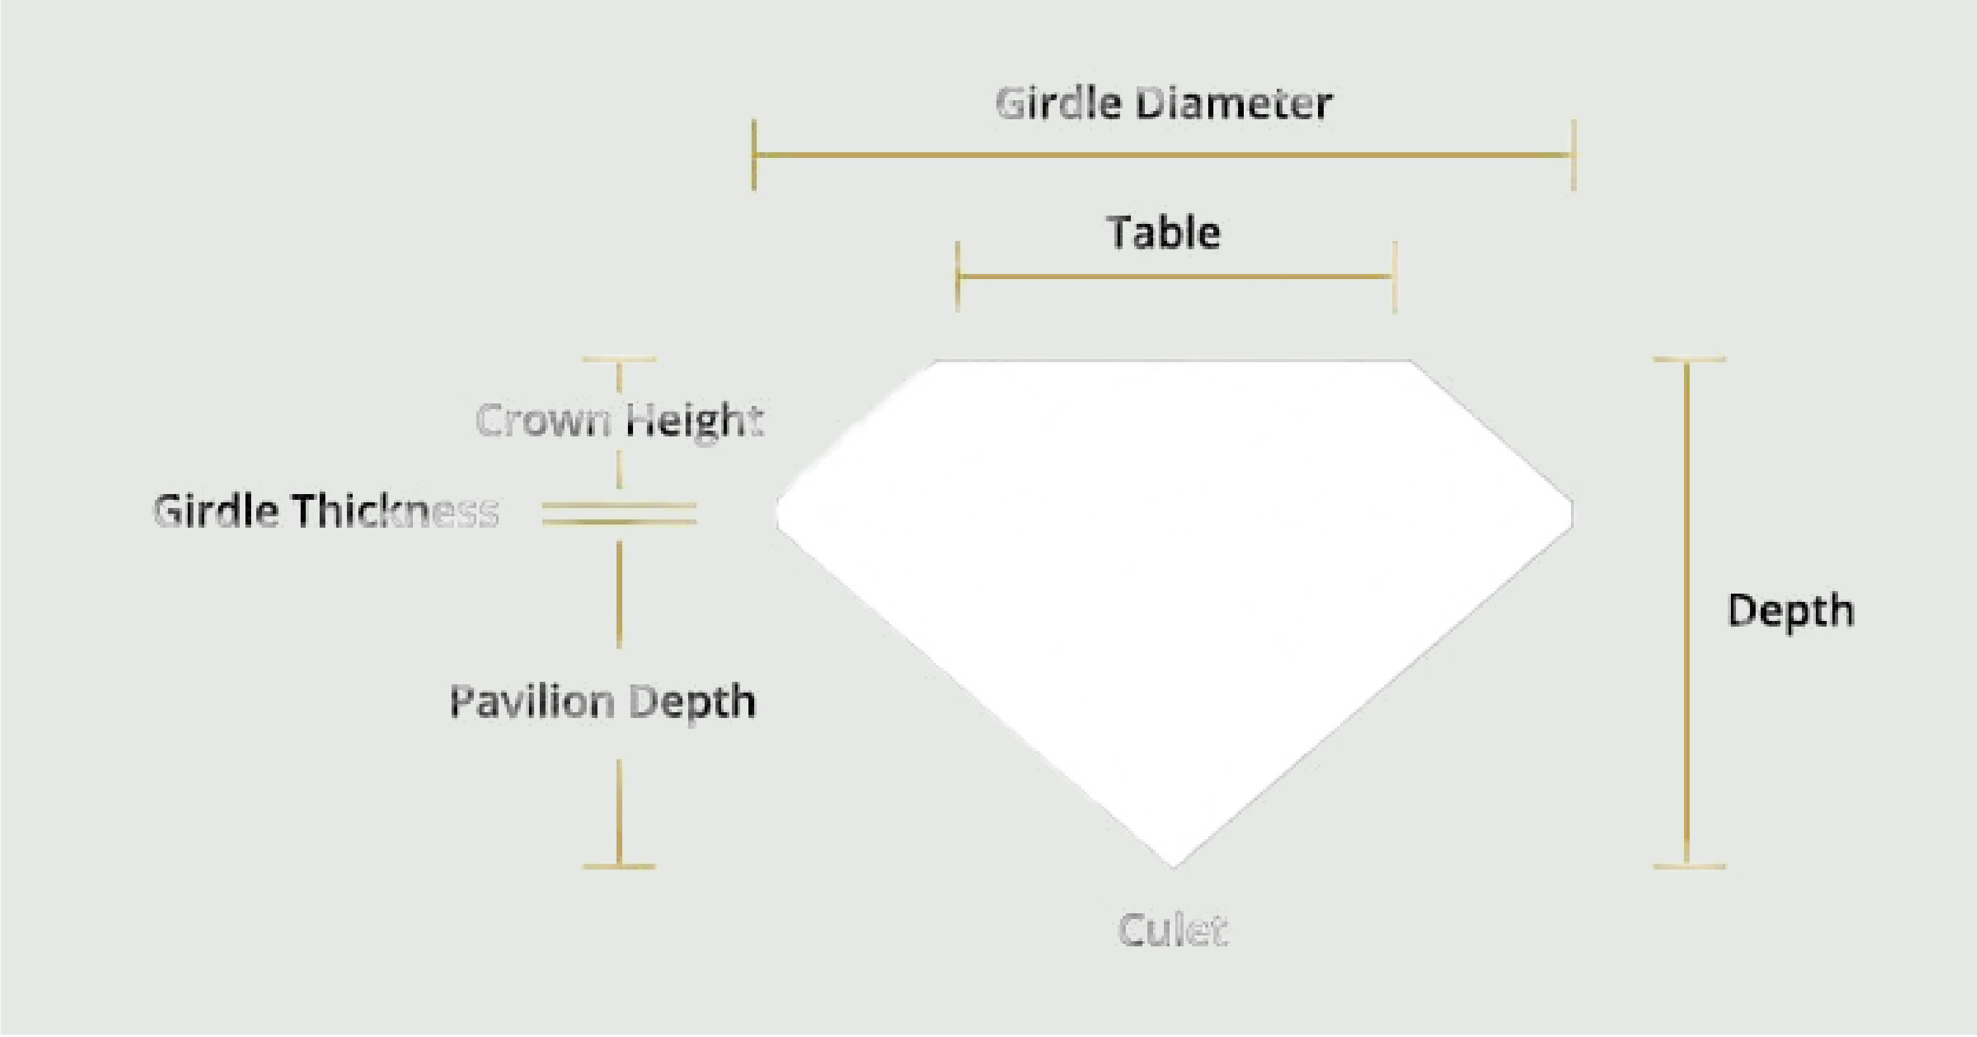
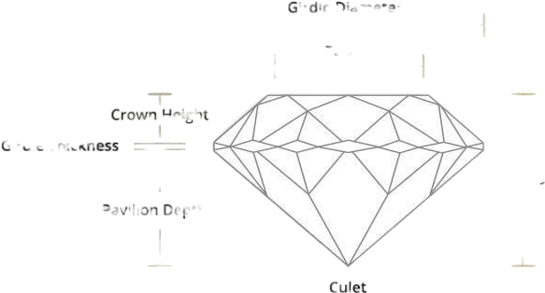



Machine learning life cycle:
The goal of the project is to build a model that can accurately predict the price of a diamond given its weight ,quality and dimensional measurements .
Problem Definition Data Collection Data Preprocessing Model Selection
Training Model Evaluation Deployment
Monitoring & Maintenance
Figure showing:Diamond Characterstics

Slide 4

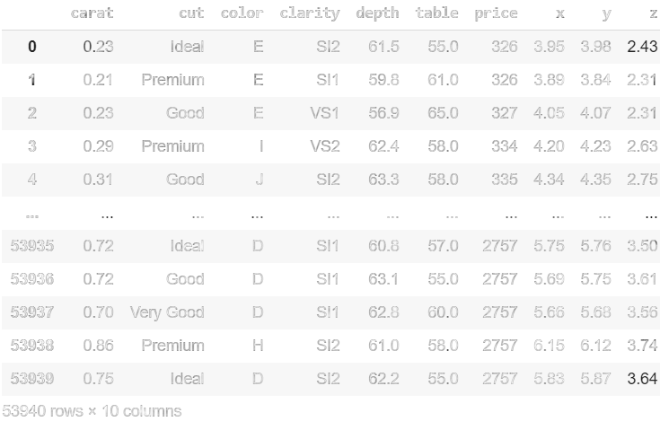
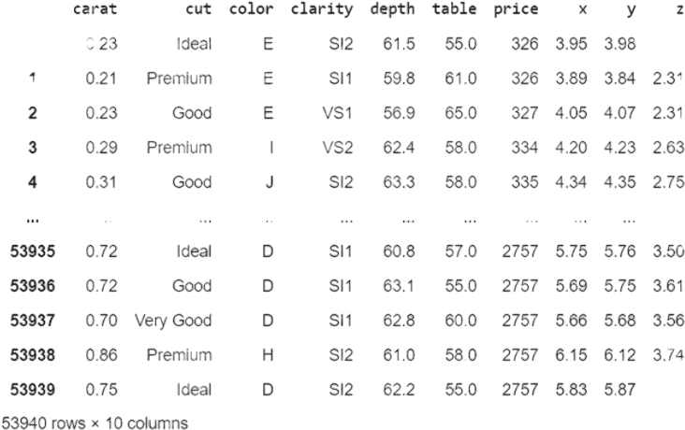
Downloaded Gemstone Prices dataset from Kaggle.com
Originally containing information on 53,940 diamonds
we narrowed ourfocus to 1,700 diamonds for analysis, with 700 having '11' clarity and 1,000 having 'VS1' clarity.
The dataset is designed for regression analysis to predict diamond prices based on 10 independent variables, including carat, cut, color, clarity, depth, table, and dimensions (x, y, z), with price as the target variable.

Slide 5

Data Cleaning Steps
Drop irrelevant features in our dataset
Check and rename/ modify some column names
Check for missing values
Remove all the rows with missing values
Data Type Verification
Outliers Resolution
Random Sampling:
Random sampling is a technique where each data point has an equal chance of being selected, ensuring an unbiased representation of the dataset.

Slide 6

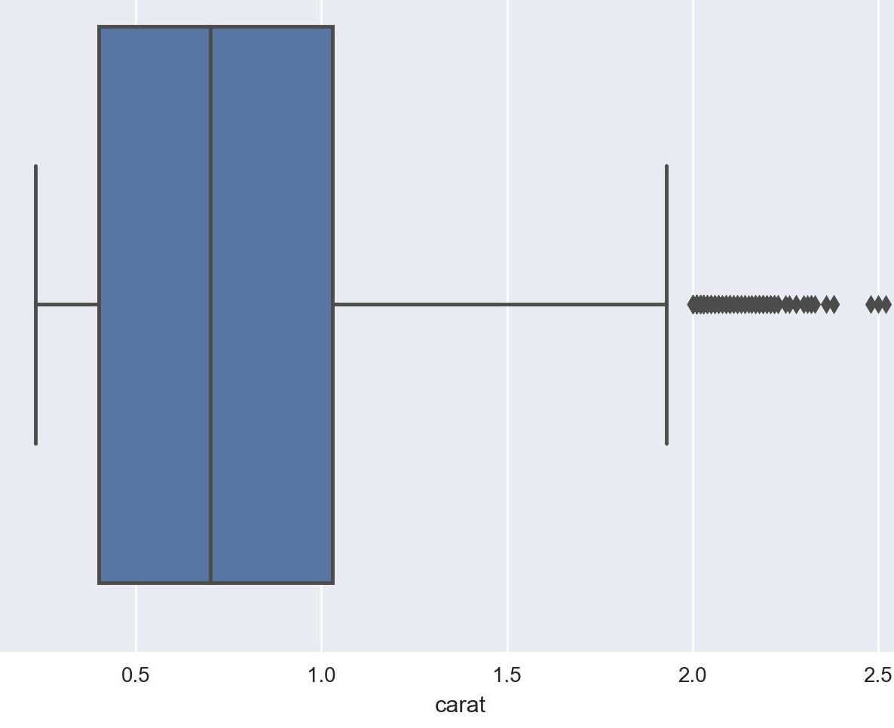
- Univariate Analysis:
-Univariate analysis examines a single variable in the dataset to understand its distribution, central tendency, and
spread.
Helps identify patterns,outliers, and data.
Histograms,Boxplots ,Bar Charts
- Bivariate Analysis:
- Bivariate analysis examines the relationship between two variables to identify correlations, trends, or dependencies.
Fig showing : Right skewed box plot

Slide 7

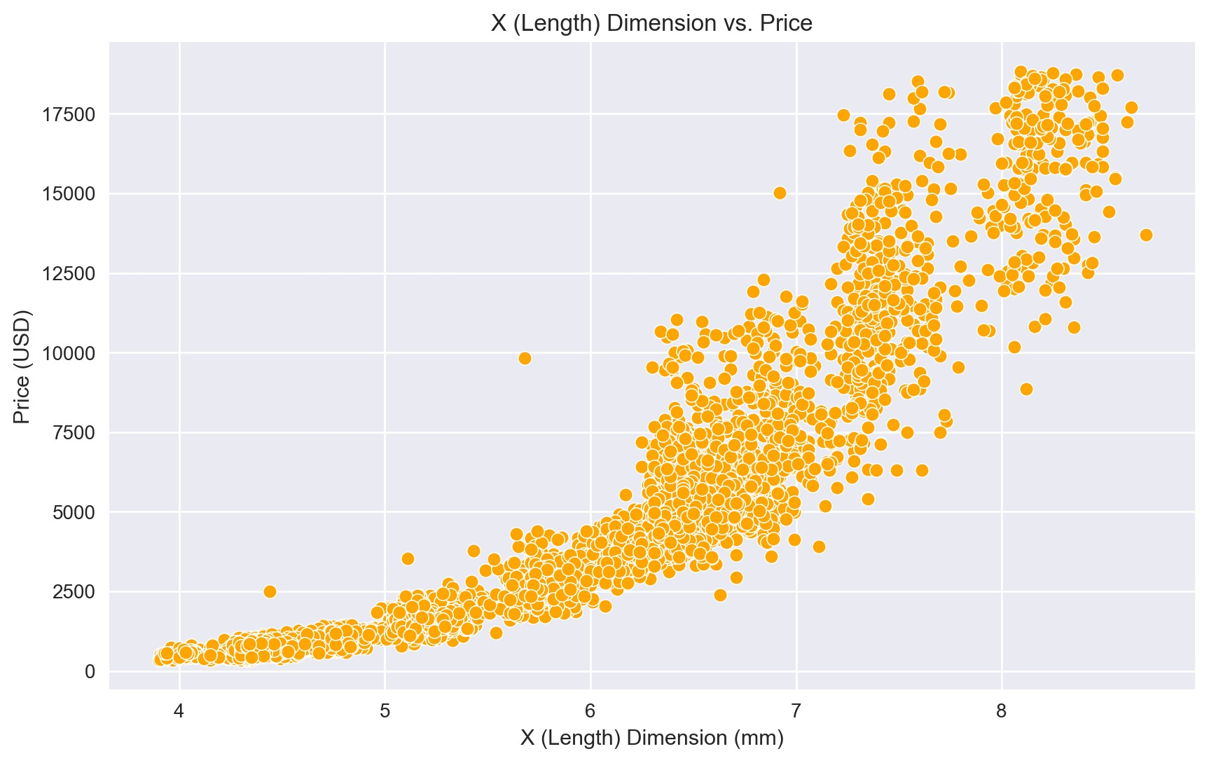
- Some of the examples of bivariate analysis are:
Scatter Plot, Box Plot, Violin Plot,
Bar Chart (Stacked or Grouped),
Heatmap (Correlation Matrix), Pairplot (Seaborn Library).
1.
Multivariate Analysis :
The multivariate analysis examines
relationships between three or more variables simultaneously to
identify complex patterns and dependencies.
Fig showing :Scatter Plot for (Length)X vs.
Price

Slide 8
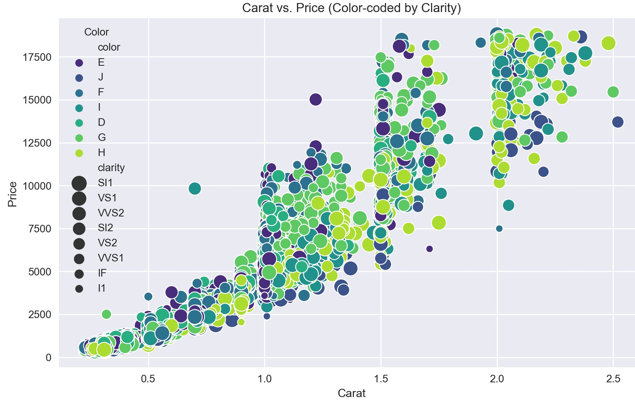
- Some of the examples of Multivariate analysis are:
Pairplot
Heatmap
(correlation matrix)
-3D Scatter Plot
Grouped Bar Chart
PCA
(Principal Component Analysis) Plot.
- Diamond price rises with carat weight, and higher clarity diamonds fetch a premium

Slide 9
Predictive Analytics
- Data Partitioning :
Training Set – Used to train the model [60 %]
Validation Set – Used to fine-tune hyperparameters [20%].
Test Set -Used to evaluate final model performance (20%).
- Model Training and Evaluation

Slide 10
ML Algorithms for Prediction
Linear Regression
Ridge Regression
Lasso Regression
Decision Tree Regressor
Recommendations:
- Use Ensemble learning technique
includes algorithms like Random Forest, Gradient Boosting (XGBoost, CatBoost), AdaBoost, Stacking

Slide 11
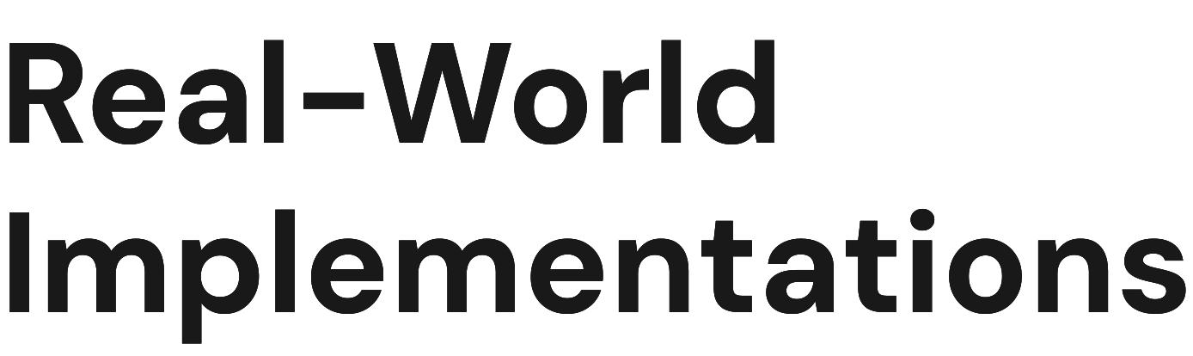
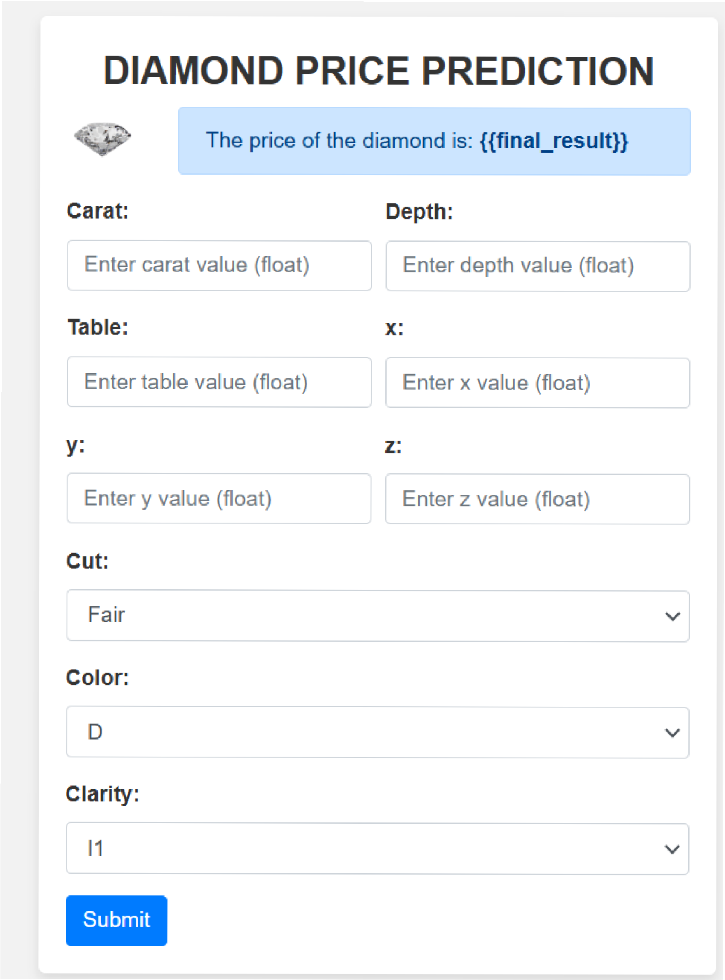
Numerous companies have successfully implemented machine learning algorithms for diamond price prediction. These implementations have led to improved pricing strategies, enhanced customer satisfaction, and increased profitability in the diamond market.

Slide 12
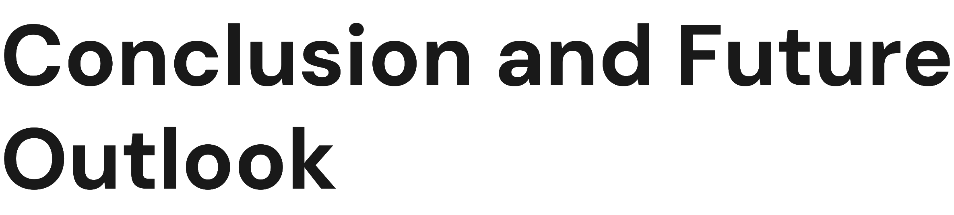
In conclusion, leveraging machine learning algorithms for diamond price prediction offers significant benefits. As technology advances, we can expect more sophisticated models that provide even greater accuracy and insights, shaping the future of the diamond industry.

Slide 13
Thank You!
Any Questions?

